Slide 1
Case Studies on Design Patterns
Design Refinements Examples

Slide 2
Outline
Case Study-1: coordination between colleagues using the Mediator pattern
Case Study-2: Job Application design using the Strategy pattern
Case Study-3: The Maze Game design using the Abstract Factory pattern

Slide 3
Case Study-1
The application consists of tracking the states of the three colleague components and keeping their state identical.
There are two versions, one with no patterns and the other with Mediator pattern.
In the simple version that does not employ any design pattern all the colleague components are tightly coupled. When one colleague changes state, it changes the others accordingly.
In the version that employs a mediator pattern, the three colleague components are completely decoupled with respect to each other. The Mediator class takes care of keeping the states of the colleagues identical.
Mediator design pattern reduces the dependency between the components and increases the reusability, extensibility and maintainability of the software architecture.

Slide 4
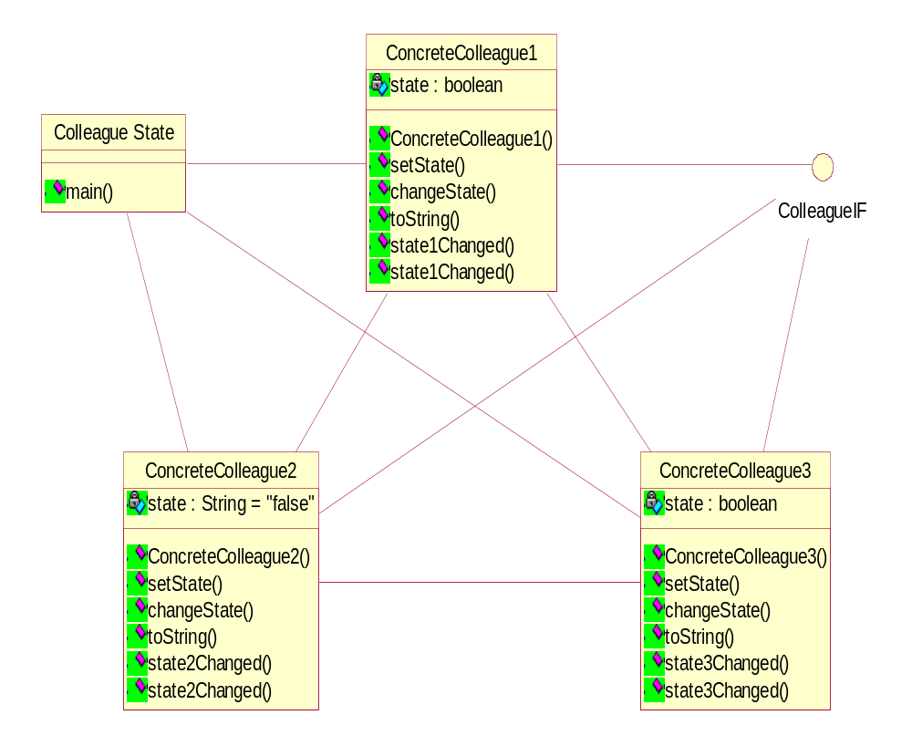
Class Diagram before applying pattern

Slide 5
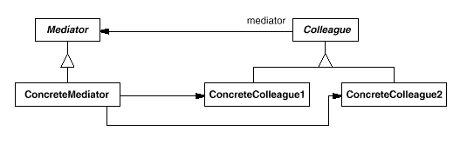
The Mediator Pattern
Intent: Define an object that encapsulates how a set of objects interact. Mediator promotes loose coupling by keeping objects from referring to each other explicitly, and it lets you vary their interaction independently.

Slide 6
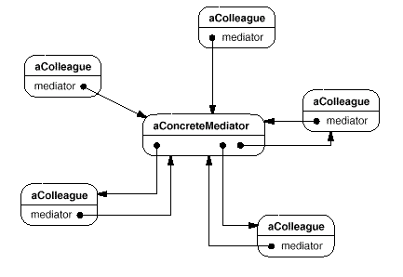
The Mediator Pattern
Colleagues send and receive requests from a Mediator object. The mediator implements the cooperative behavior by routing requests between the appropriate colleague(s).

Slide 7
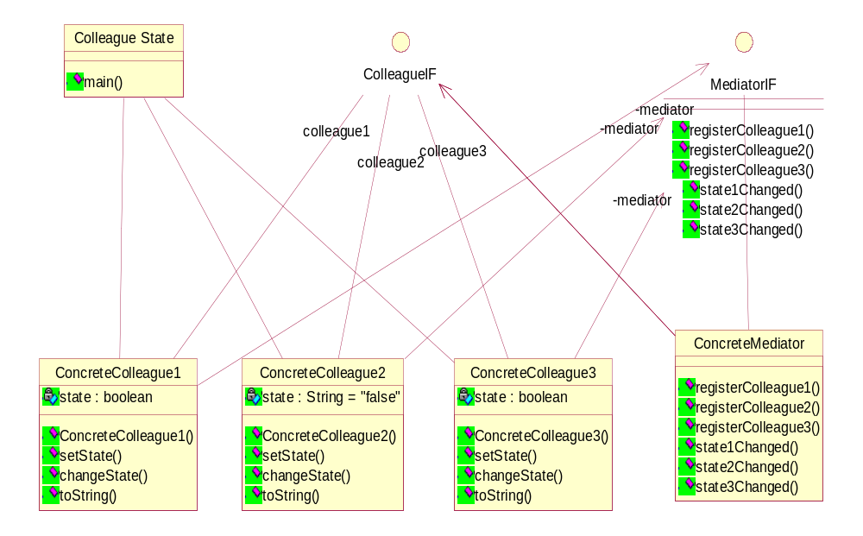
Class Diagram after applying mediator

Slide 8
Case Study-2
The application consists of processing job applications applied to various positions.
There are two versions, one with no patterns and the other with Strategy pattern.
The simple version which does not employ any design pattern uses a switch case in the validate method to process each job application basing on the position applied to.
In the version that employs strategy pattern, each switch case is considered as a strategy, a subclass of the abstract class-Form Validator.
The advantages of this pattern are elimination of conditional statements and easier to extend new strategies without recoding the application.

Slide 9
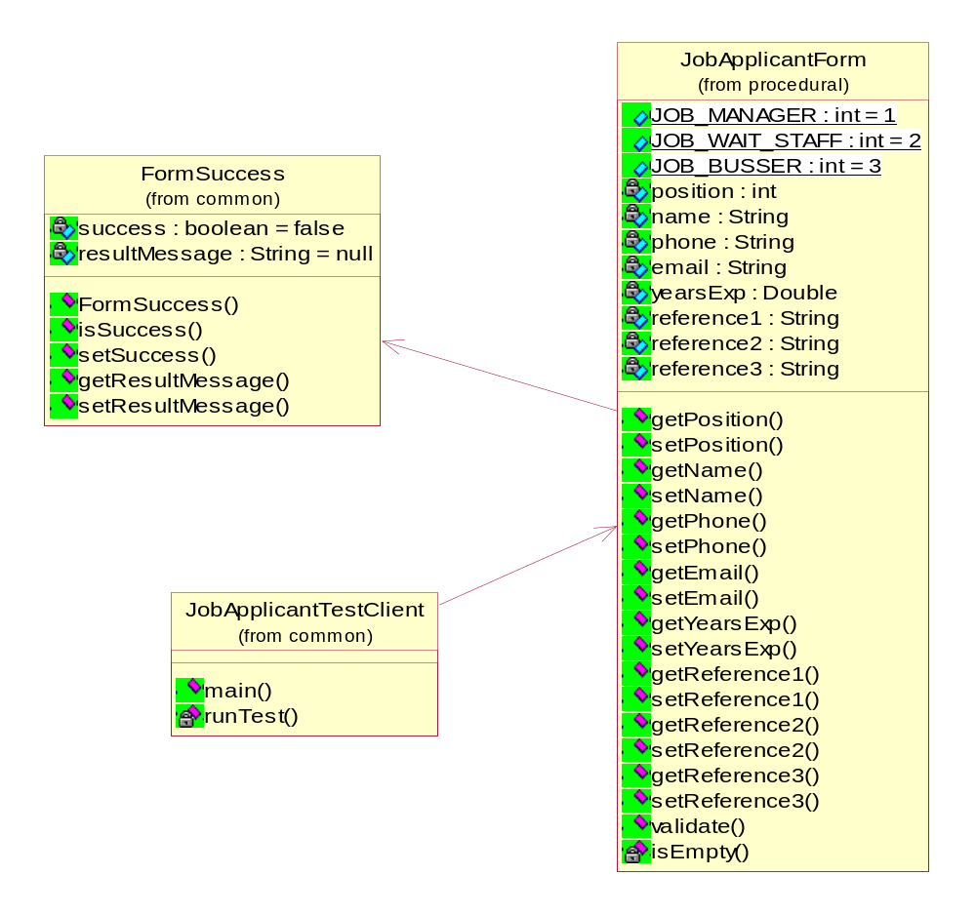
Class Diagram before applying pattern

Slide 10
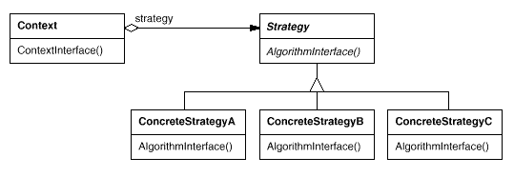
The Strategy Pattern
The Strategy Pattern: lets the algorithm vary independently from clients that use it
Interface Class
Abstract Class
Default
Strategy
Strategy A
Strategy B
Strategy C

Slide 11
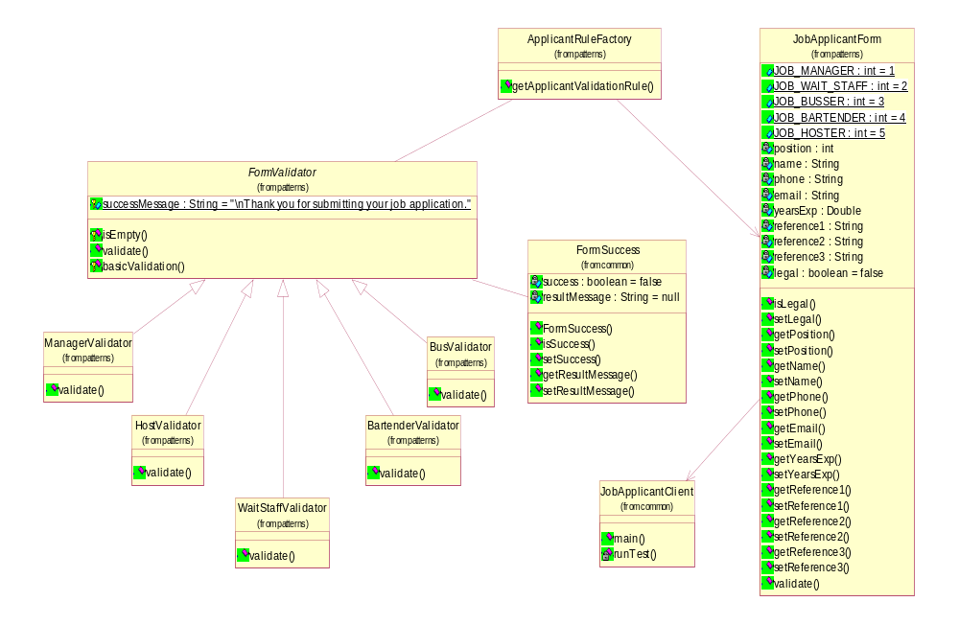
Class Diagram after applying strategy

Slide 12
Case Study-3
This application consists the design of a game called maze.
There are two versions, one with no patterns and the other with Abstract Factory pattern.
In the version that employs abstract factory pattern, the two different designs are implemented as two different families.
The benefits of this design pattern are to isolate the concrete components and help in exchanging the product families.

Slide 13

The Abstract Factory Pattern
Intent: Provide an interface for creating families of related or dependent objects without specifying their concrete classes

Slide 14
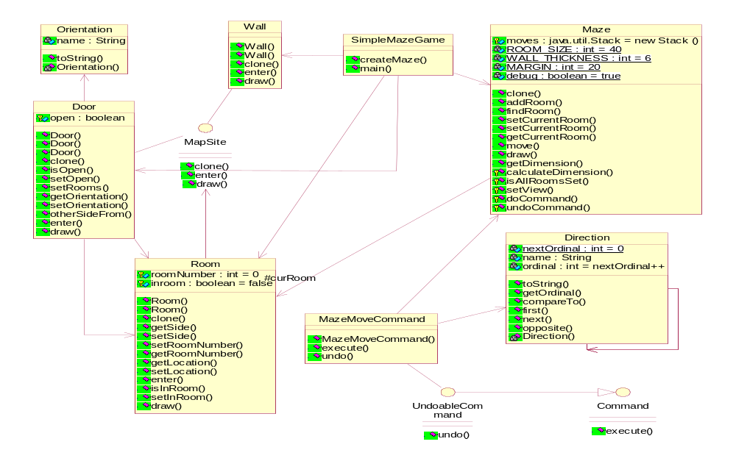
Class Diagram before applying pattern

Slide 15
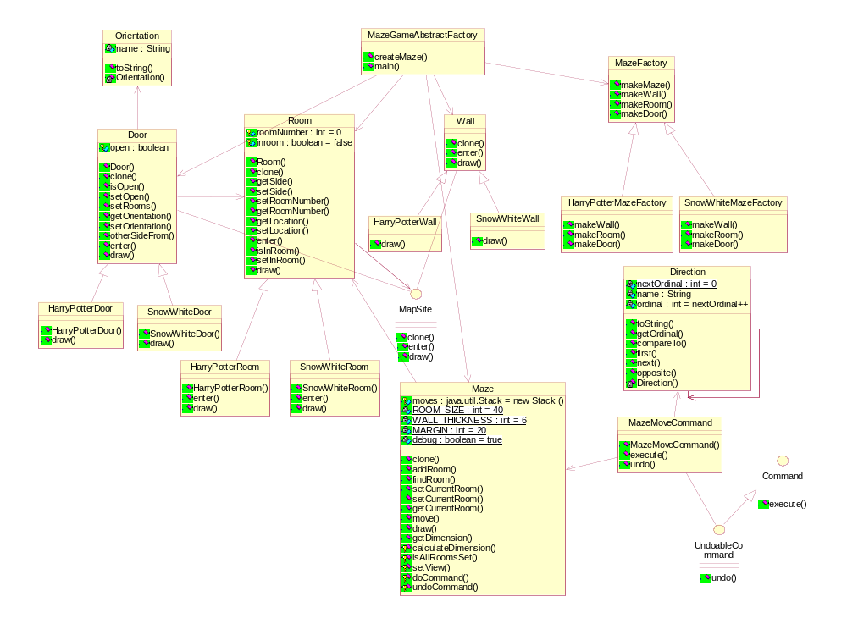
Class Diagram after applying abstract factory

